Slide 1
Current and Future Organisations
Gartner Magic quadrants

Slide 2
Gartner Magic Quadrants
A research methodology and visualization tool for monitoring and evaluating the progress and positions of companies in a specific, technology-based market.
Instead of simply showing statistics or ranking companies in lists, it uses a two-dimensional matrix to illustrate the strengths and differences between companies.
The display divides competing businesses into four distinct sections, based on both completeness of vision and ability to execute it.
Source: http://whatis.techtarget.com/definition/Gartner-Magic-Quadrants

Slide 3
Gartner Magic Quadrant
It provides a graphical competitive positioning of four types of technology providers:
Leaders execute well against their current vision and are well positioned for tomorrow.
Visionaries understand where the market is going or have a vision for changing market rules, but do not yet execute well.
Niche Players focus successfully on a small segment, or are unfocused and do not out-innovate or outperform others.
Challengers execute well today or may dominate a large segment, but do not demonstrate an understanding of market direction.

Slide 4
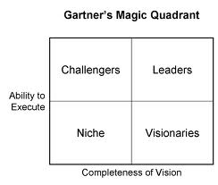
Gartner Magic Quadrant

Slide 5
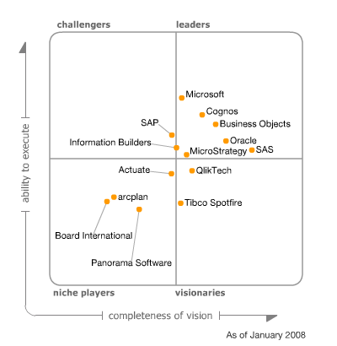
GMQ – An example

Slide 6
Future Trends…
Digital Natives
Mobile Apps..
BYOD..
Big Data..
Social Media and Digital Marketing…
Global Supply Chain …
Cloud Computing..

